Slide 1
Agrégation spatiotemporelle pour la visualisation de traces d’exécution
Damien Dosimont
Advisor: Guillaume Huard – Co-advisor: Jean-Marc Vincent

Slide 2

Context

Slide 3


Systems and applications become more and more complex…
…to analyze

Slide 4






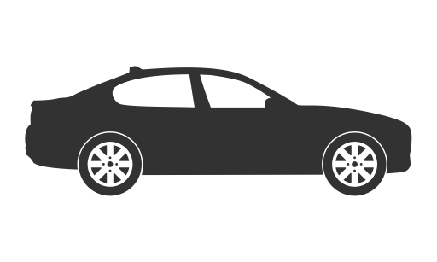






Embedded systems
Not developer
friendly
Real time
f(x)/s
Quantity of
events over time
Deep software
stack
Step-by-step debugger (ex: GDB)

Slide 5



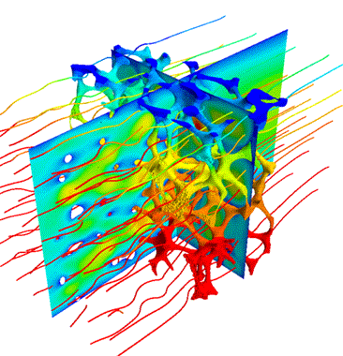













Parallel systems
Indeterminism
Middlewares
f(x)/s
Complex
& Distributed
Artchitecture
Quantity of
events over time
Resource
sharing
Step-by-step debugger (ex: GDB)

Slide 6





Trace Analysis
Complex system/application
Collect information about the execution and save them in a file
Process trace data
Statistics
A
Automatic approach
Analyze the content
Visualization

Slide 7

Main thread

Slide 8


TS Record use case
Streaming
Record
TV program
Set-top box
Hard drive

Slide 9

May the quality of service be with you

Slide 10
How to analyze this application?
?

Slide 11


Knowledge on the application
IP buffers
Memory
Hard drive
IP packets
sys_write()
flush-8:0
every
100 ms
Disk cache
every
5000 ms
230 KB

Slide 12
How we imagine analyzing the application
Space-time diagram inspired by Gantt Chart

Slide 13
How we imagine analyzing the application

Slide 14
How we imagine analyzing the application
Function green(){
…
}
Function red(){
…
}
Function purple(){
…
}

Slide 15
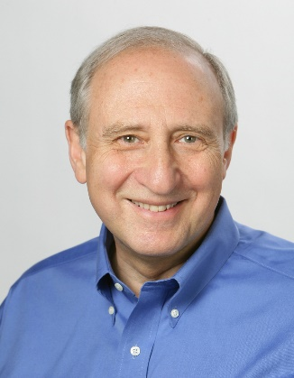




Shneiderman’s mantra
Overview first,
Zoom
and
Filter,
then
Details-on-demand
}

Slide 16
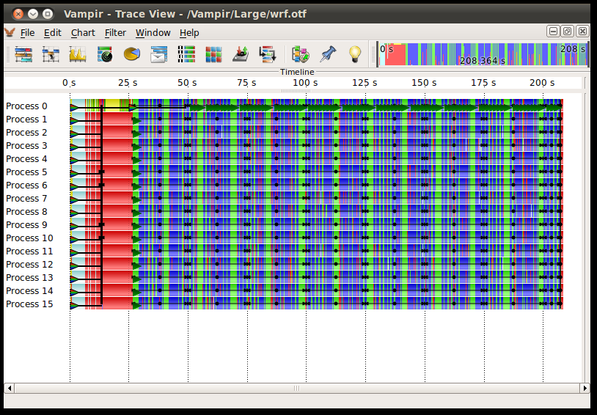
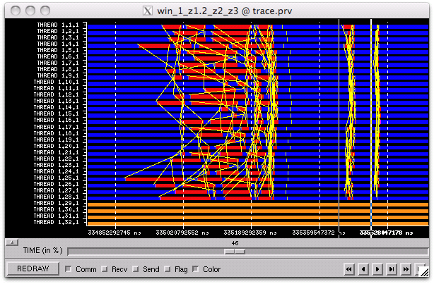
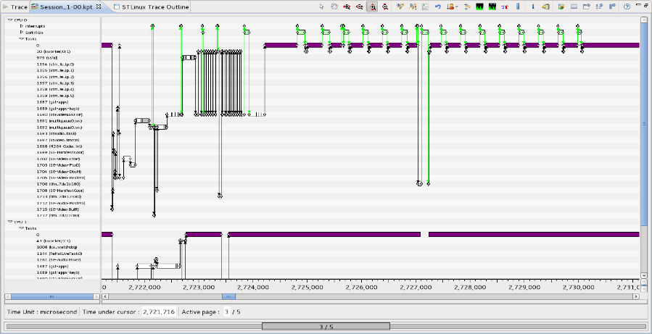
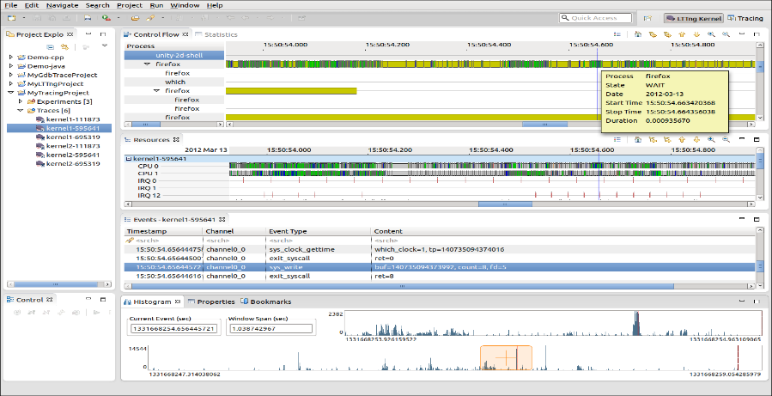
Examples of tools using Gantt chart
Vampir
Paraver
T-Charts (Lite)
Trace Compass

Slide 17





What about scalability?

Slide 18
A few figures…
TS Record use case
82 seconde duration
258,519 events
12.7 MB
482 seconde duration
1,642,033 events
83.3 MB
LU class C 700 MPI threads running on G5K (Nancy)
71 seconde duration
218,457,456 events
12.3 GB

Slide 19

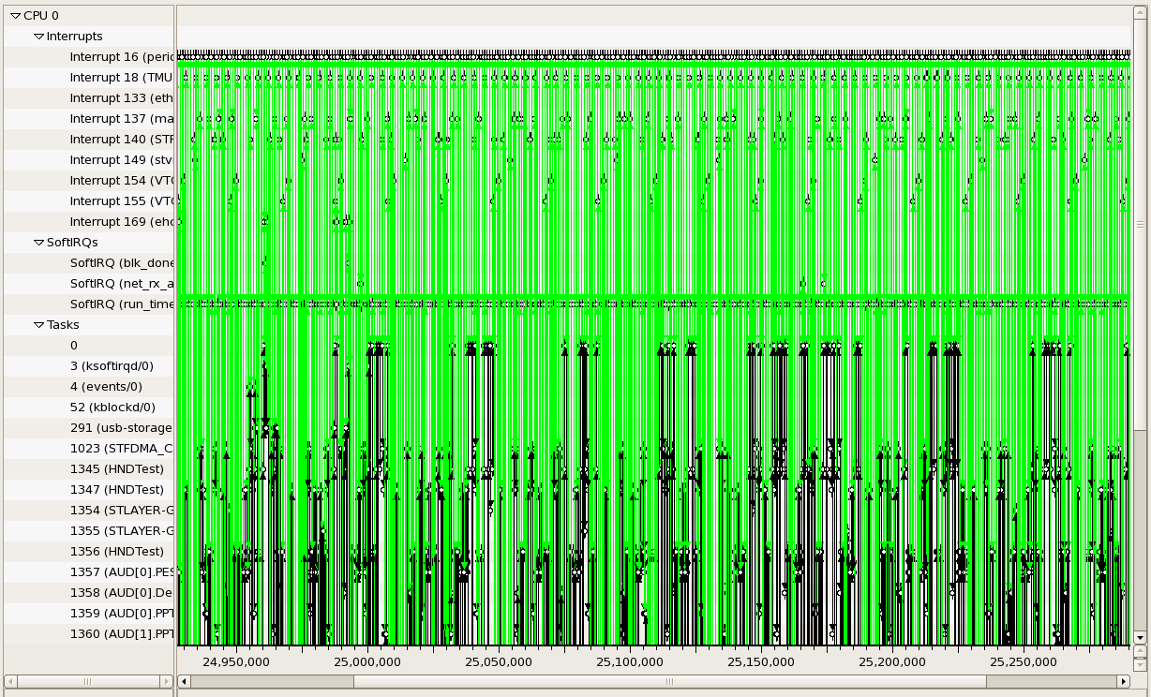
Visualization support

Slide 20
Visualization support
+
=
≈
6 graphical objects
4 available pixels
Fitting graphical
objects with pixels
Final representation:
-some objects are lost
-proportions are not kept

Slide 21



Performance
Memory Limitations
Hardware performance
Algorithmic complexity
Libraries, components, languages, etc.

Slide 22

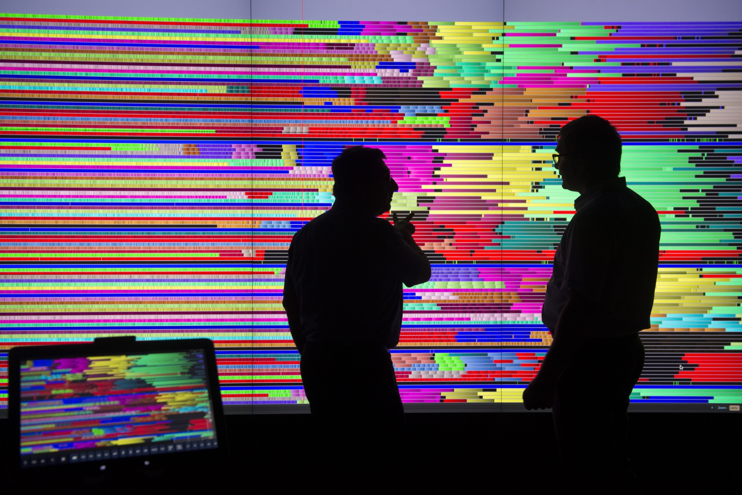
User

Slide 23

Shneiderman’s mantra
Overview first,
Zoom
and
Filter,
then
Details-on-demand
}

Slide 24

Proposal

Slide 25
Fulfill all Shneiderman’s mantra steps

Slide 26






Summary
Context
Proposal
Lamarche-Perrin’s Method
Temporal Aggregation
Spatiotemporal Aggregation
Implementation: Ocelotl Analysis Tool
Conclusion

Slide 27
Lamarche-Perrin’s Method

Slide 28



Multi agent system analysis
Analytic approach
Complex
System
Microscopic
Obervation
Microscopic
Representation
Analyst
Complexity
Quantity of data

Slide 29


Multi agent system analysis
Systemic approach
Microscopic
Representation
Abstraction
Complex
System
Microscopic
Obervation
Macroscopic
Representation
Analyst

Slide 30

Lamarche-Perrin’s method
Microscopic
Representation
Abstraction
Complex
System
Microscopic
Obervation
Macroscopic
Representation
Method based on Partition+Aggregation
Analyst

Slide 31
From the partition to the interpretation
5
5
1
15
5
9
5
1
1
1
2
6
3
4
3
Partition
Aggregation
(sum)
Redistribution
(uniform)
Visualization

Slide 32
How to choose the « good » partitions?
?

Slide 33
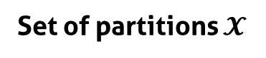

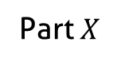
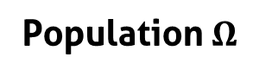
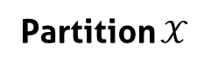
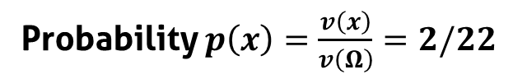
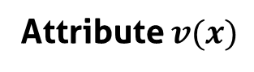
Notations
Part $X$
5
Population $Ω$
1
5
9
1
Individuals $x$
9
1
1
4
2
Attribute $v(x)$
2
4
Probability $p\left(x\right)=\frac{v\left(x\right)}{v\left(Ω\right)}=2/22$
Partition $𝒳$
Set of partitions $𝓧$
5
5
1
5
5
5
1
1
9
1
1
9
9
1
9
9
1
1
1
1
2
2
2
2
4
…
4
4
4
4
2

Slide 34
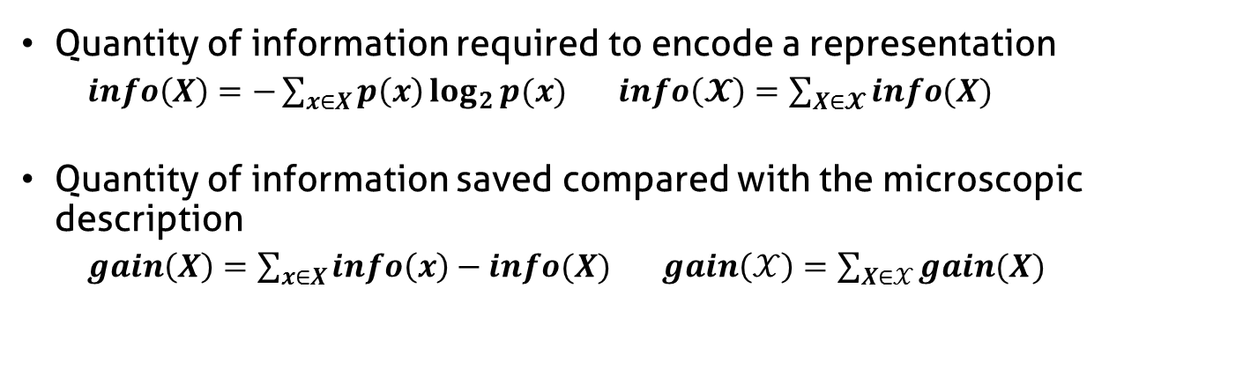
Complexity reduction
Quantity of information required to encode a representation
$info\left(X\right)=−\sum_{x∈X}{p\left(x\right)\log_{2}{p(x)}}$ $info\left(𝓧\right)=\sum_{X∈𝓧}{info(X)}$
Quantity of information saved compared with the microscopic description
$gain\left(X\right)=\sum_{x∈X}{info\left(x\right)−info(X)}$ $gain\left(𝒳\right)=\sum_{X∈𝒳}{gain(X)}$
Complexity reduction
5
5
5
1
1
1
1
1
1
9
9
9
2
2
2
4
4
4
Number of elements (aggregates)

Slide 35
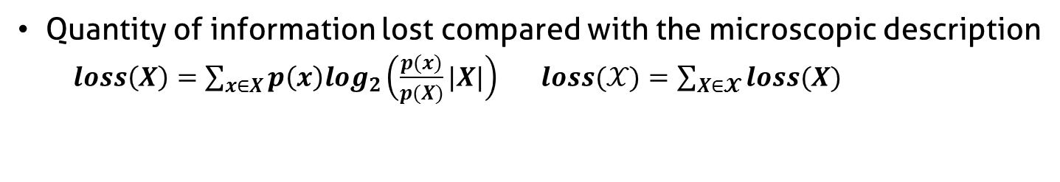
Information Loss
Quantity of information lost compared with the microscopic description
$loss\left(X\right)=\sum_{x∈X}{p\left(x\right)log_{2}\left(\frac{p(x)}{p(X)}|X|\right)}$ $loss(𝒳)=\sum_{X∈𝓧}{loss(X)}$
5
High
Information Loss
4
1
1
4
4
9
4
4
4
4
4
5
Low
Information Loss
4
4
4
4
4
4
4
4
4
3
4

Slide 36
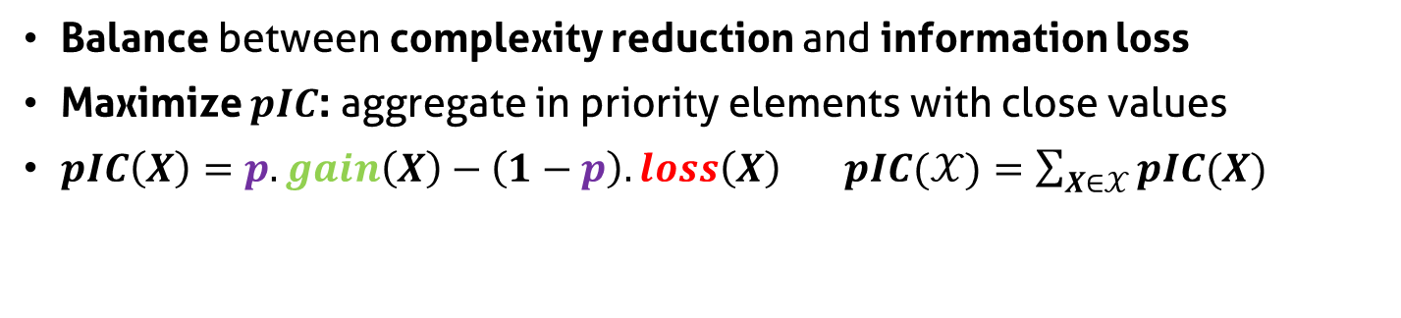
Parametrized Information Criterion
Balance between complexity reduction and information loss
Maximize $pIC$: aggregate in priority elements with close values
$pIC\left(X\right)=p.gain\left(X\right)−\left(1−p\right).loss\left(X\right)$ $pIC(𝒳)=\sum_{X∈𝒳}{pIC(X)}$
Parameter p
Complexity reduction
5
5
5
1
1
1
1
1
1
9
9
9
2
2
2
4
4
4
Information loss

Slide 37

Constrain the set of partitions
Reduce set of partition size
Decrease algorithmic complexity
Bring coherence with syntaxic and semantic characteristics of the system

Slide 38

Temporal Analysis

Slide 39
Interest of Temporal Analysis

Slide 40
How to adapt LP method to trace analysis ?
?
?
?
Microscopic
Representation
?
Abstraction
Complex
System
Microscopic
Obervation
?
Macroscopic
Representation
Analyst

Slide 41

Trace content
Microscopic
Representation
Abstraction
Trace
Microscopic
Obervation
Macroscopic
Representation
Analyst

Slide 42





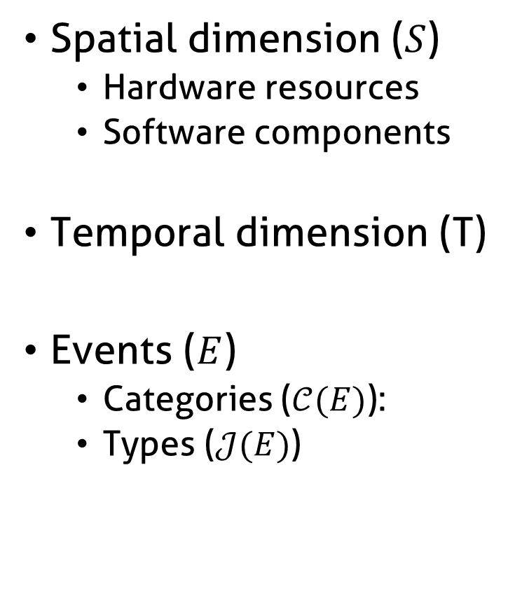
Trace content
Spatial dimension ($S$)
Hardware resources
Software components
Temporal dimension (T)
Events ($E$)
Categories ($𝒞(E)$):
Types ($𝒥(E)$)

Slide 43
How to adapt LP method to trace analysis
Microscopic
Representation
Abstraction
Trace
Microscopic
Obervation
Macroscopic
Representation
Analyst

Slide 44
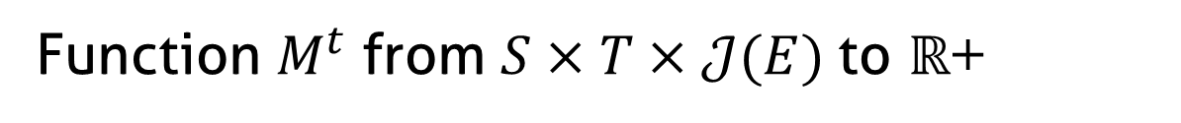
Microscopic model structure
Function $M^{t}$ from $S×T×𝒥(E)$to $ℝ$+
J5
J4
J3
Event types
J2
J1
s1
Space
s2
s3
t1
t2
t3
t4
t5
Time (discrete)

Slide 45
Fill the microscopic model
Time (continuous)
Sum of state durations
s1
s2
Time slice
Space
s3
d1 + d2 + p1*d3
s1
d1+d2+p1*d3
s2
Space
s3
t1
t2
t3
t4
t5
Time (discrete)

Slide 46
Aggregate the microscopic model
Original algorithm:
scalar values
t1
t2
t3
t4
t5
Time (discrete)
Objective:
multidimensional
values
t1
t2
t3
t4
t5
Time (discrete)

Slide 47



Partition/Aggregation pipeline
Microscopic
Representation
Abstraction
Trace
Microscopic
Obervation
Macroscopic
Representation
Quality
Measures
Best Cut
Computation
Partition
Computation
Visualization
Technique
Analyst

Slide 48
Best Cut Algorithm : naive approach
Decomposition
Recursion
Decomposition
Recursion
Decomposition

Slide 49
Best Cut Algorithm : dynamic programming
Decomposition
Recursion
Save the intermediate results
Decomposition
Recursion
Decomposition
Avoid redundant evaluation

Slide 50
Visualization
Microscopic
Representation
Abstraction
Trace
Microscopic
Obervation
Macroscopic
Representation
Quality
Measures
Best Cut
Computation
Partition
Computation
Visualization
Technique
Analyst

Slide 51
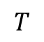
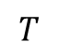
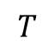
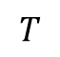
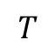
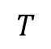
Visualize the trace abstraction
Bar chart
$$T$$
Colored
partition
$$T$$
$$T$$
Stacked bar
chart
$$T$$
$$T$$
Mode
$$T$$
Spatial aggregation
Aggregation of event types

Slide 52
Stacked bar chart visual aggregation
minimal height
blue + orange event type
total height < minimal height
blue event type
height < minimal height
blue + orange event type
individual height < minimal height
total height > minimal height
Decrease available height

Slide 53
Example of analyses

Slide 54
TS Record analysis

Slide 55
Solving the problem
IP buffers
Memory
Hard drive
IP packets
sys_write()
flush-8:0
every
100 ms
Disk cache
every
5000 ms
230 KB
quantity of data
During the flush, the cache is locked
Writing on the USB disk is slow, IP buffers are overflowed
Linux configuration: flush should depend on quantity of data and not on time

Slide 56
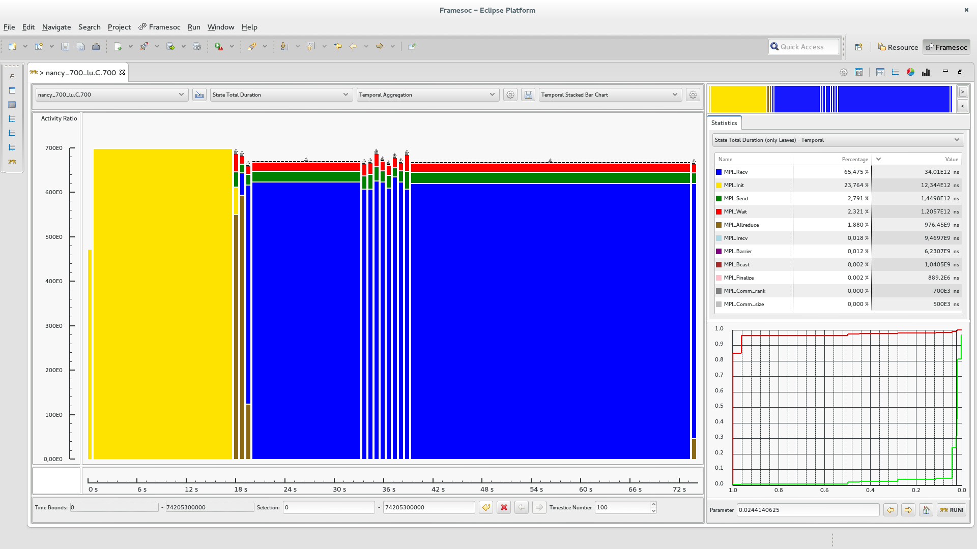
LU class C (700 processes) on G5K
MPI_Allreduce
MPI_Wait
MPI_Send
700
Activity Ratio
0
0 s
74 s
Time
MPI_Recv
MPI_init

Slide 57

We need some space!

Slide 58

Spatiotemporal Analysis
+

Slide 59




Hardware/software hierarchy
Hardware components
Site
Clusters
Nodes
Cores
Threads
Software components

Slide 60
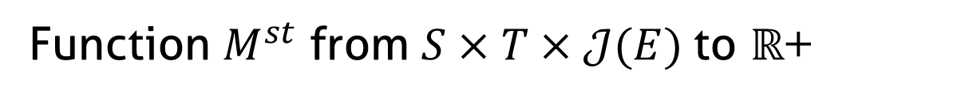
Microscopic model structure
Function $M^{st}$ from $S×T×𝒥(E)$to $ℝ$+
Event types
J3
J2
J1
s1
s2
Space
s3
s4
s5
t1
t2
t3
t4
t5
Time (discrete)

Slide 61
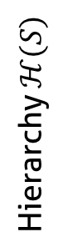
Hierarchize the spatial dimension
Function $M^{st}$ from $S×T×𝒥(E)$to $ℝ$+
Event types
J3
J2
J1
s1
Sa
s2
Hierarchy $ℋ(S)$
s3
S
s4
Sb
s5
t1
t2
t3
t4
t5
Time (discrete)

Slide 62
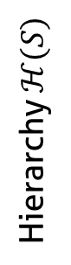
Aggregate the microscopic model
s1
Sa
s2
Hierarchy $ℋ(S)$
s3
S
s4
Sb
s5
t1
t2
t3
t4
t5
Time (discrete)

Slide 63
Forbidden Aggregates
s1
Sa
s2
Hierarchy $ℋ(S)$
s3
S
s4
Sb
s5
t1
t2
t3
t4
t5
Time (discrete)

Slide 64
Best Cut Algorithm: naive approach
Spatial or
Temporal
Cut
Recursion
Spatial or
Temporal
Cut
Recursion
Spatial or
Temporal
Cut

Slide 65

Best Cut Algorithm: dynamic programming
Save the intermediate results
Avoid redundant evaluation
Spatial or
Temporal
Cut
Unavoidable redundancy
Recursion
Spatial or
Temporal
Cut
Recursion
Spatial or
Temporal
Cut

Slide 66
Visualize the abstraction

Slide 67
Visual aggregation
Decrease available height

Slide 68
Example of analyses

Slide 69
LU class C (700 processes) on G5K
MPI_Allreduce
MPI_Wait
MPI_Send
700
Activity Ratio
0
0 s
74 s
Time
MPI_Recv
MPI_init

Slide 70
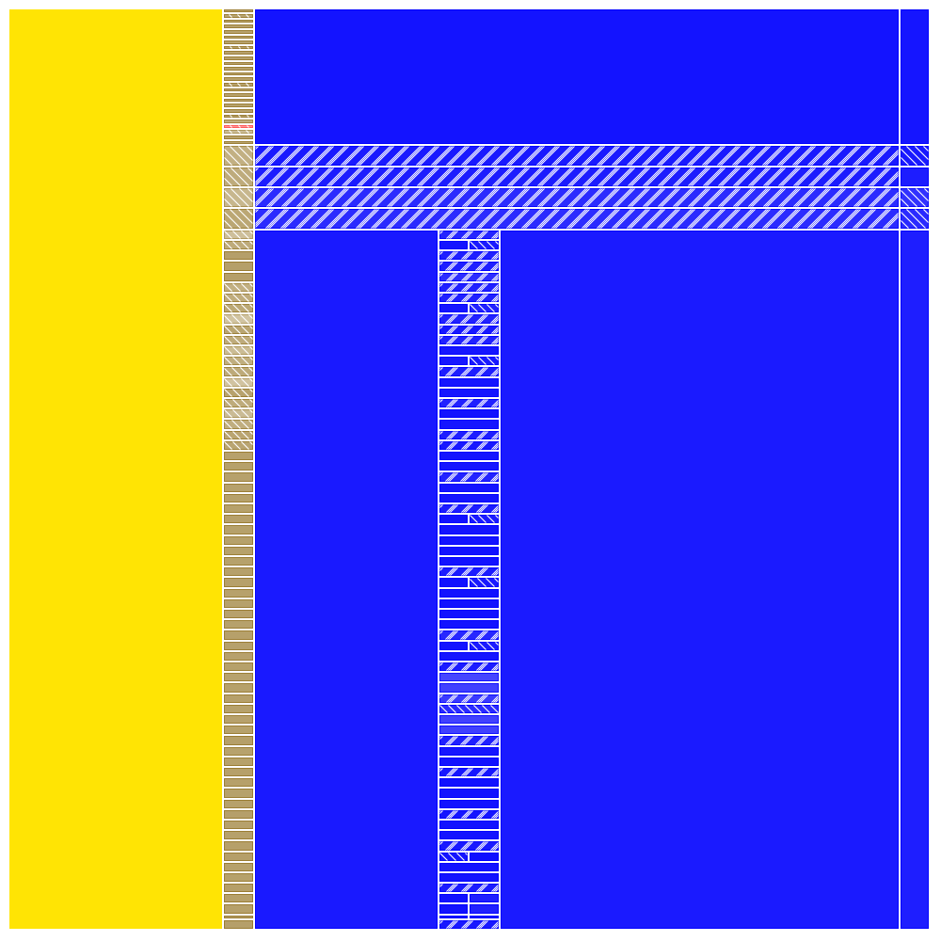
LU class C (700 processes) on G5K
graphene
graphite
Nancy
griffon
MPI_Allreduce
MPI_Recv
MPI_init
0 s
Time
74 s

Slide 71
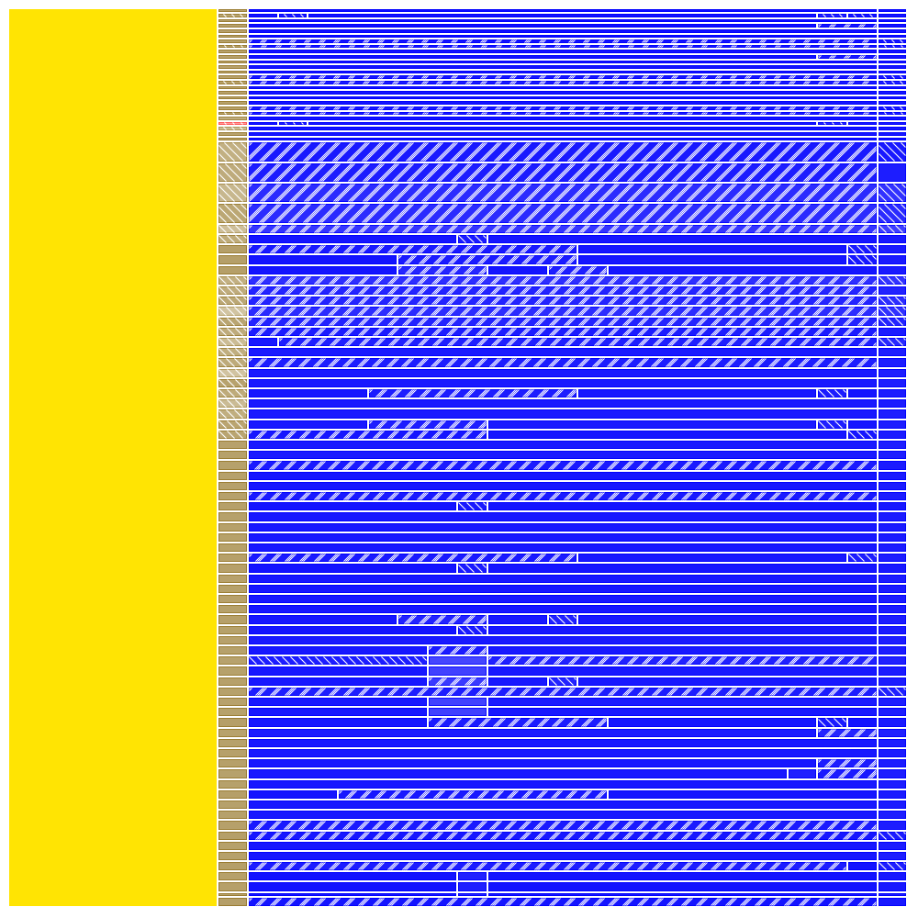
LU class C (700 processes) on G5K
Nancy
(no cluster/machine
level)
MPI_Allreduce
MPI_Recv
MPI_init
0 s
Time
74 s

Slide 72

Implementation: Ocelotl Analysis Tool

Slide 73
Presentation

Slide 74
Ocelotl Architecture

Slide 75
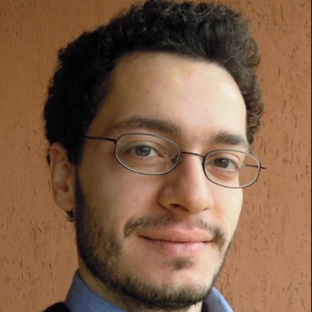

Framesoc

Slide 76
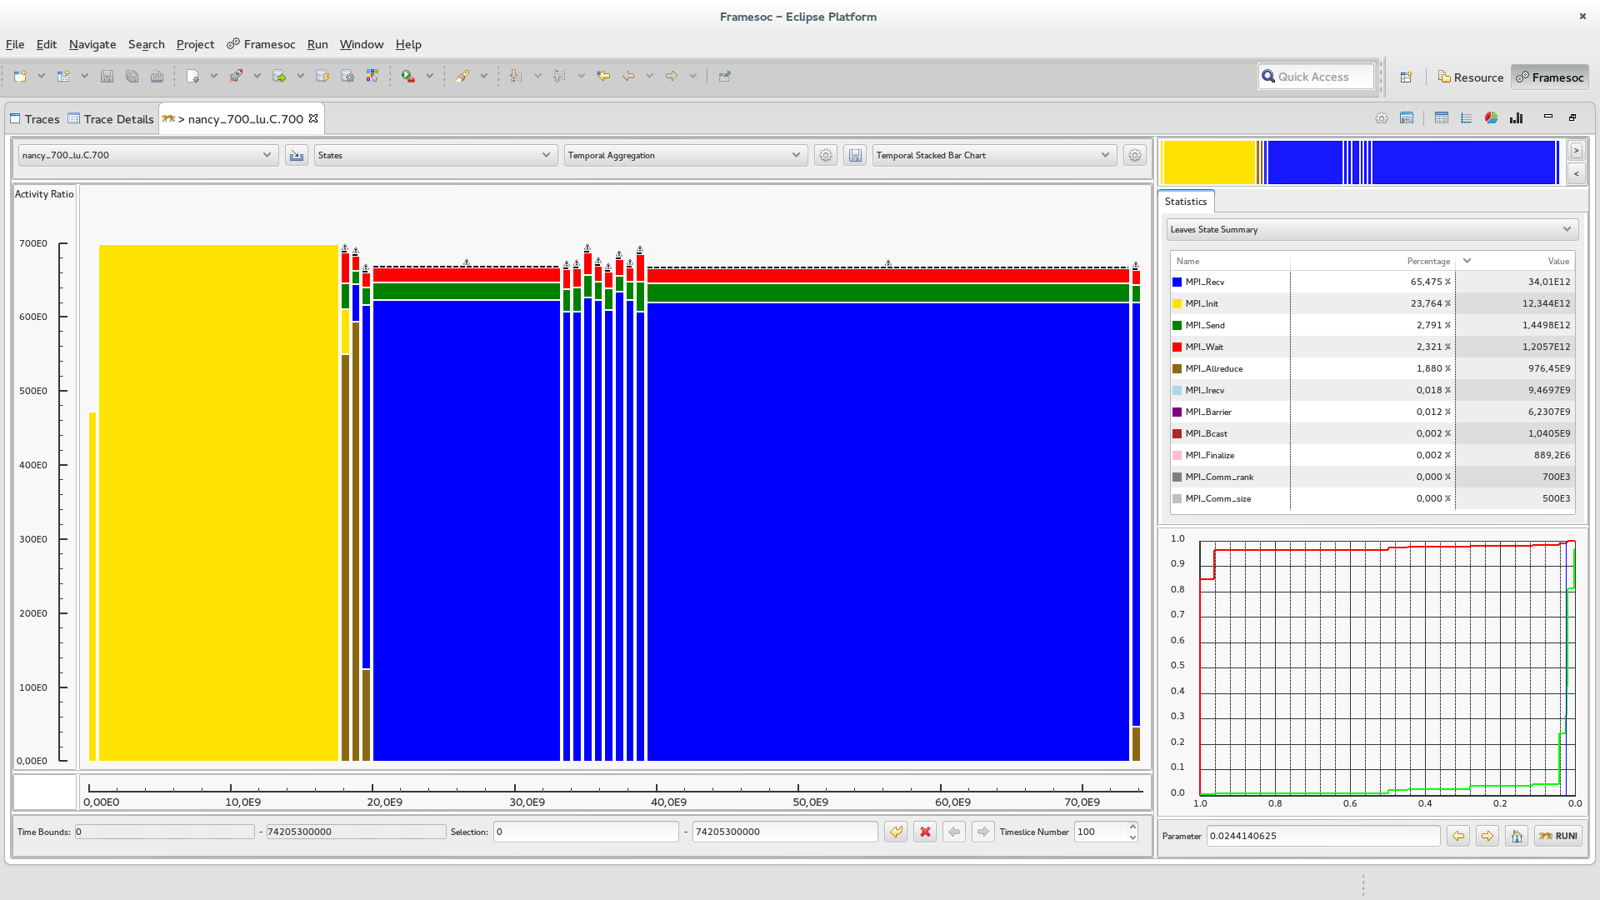
Shneiderman’s mantra: Overview

Slide 77
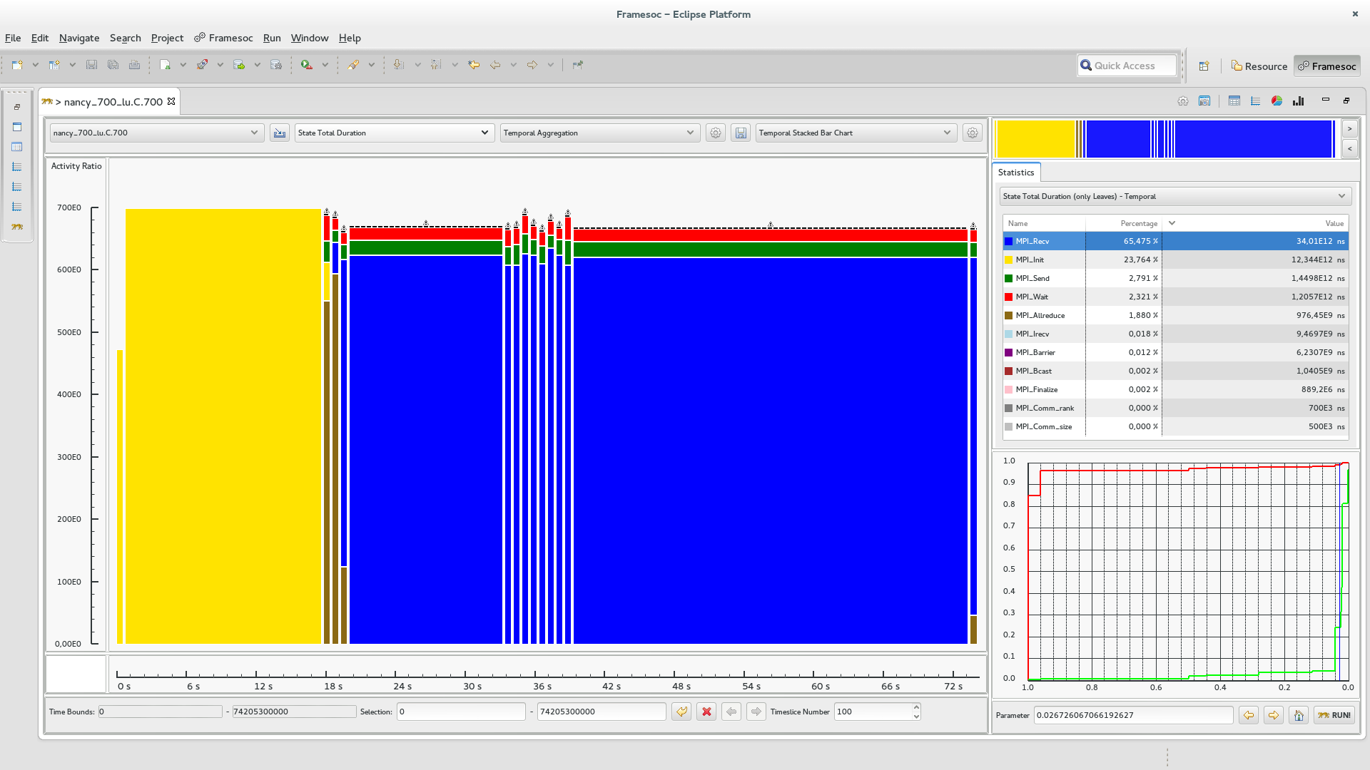
Shneiderman’s mantra: Zoom

Slide 78
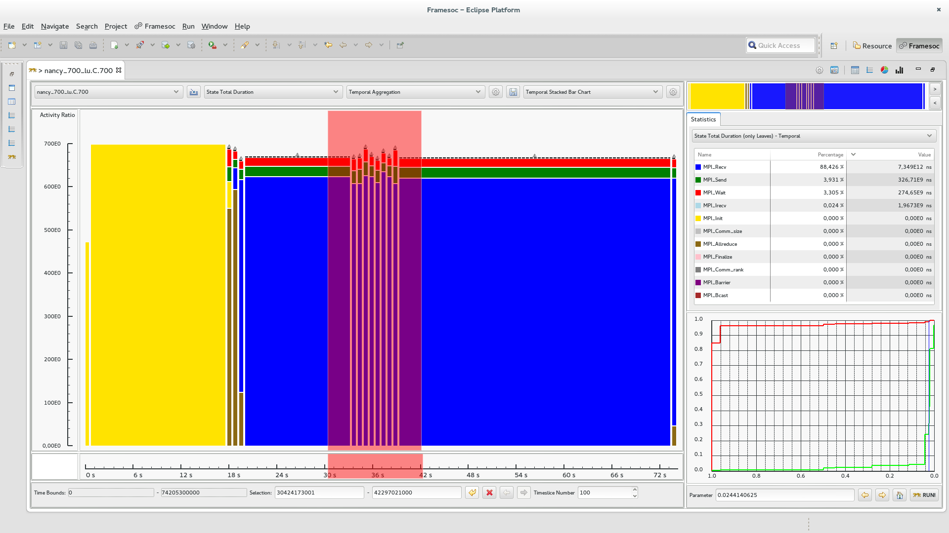
Shneiderman’s mantra: Zoom

Slide 79
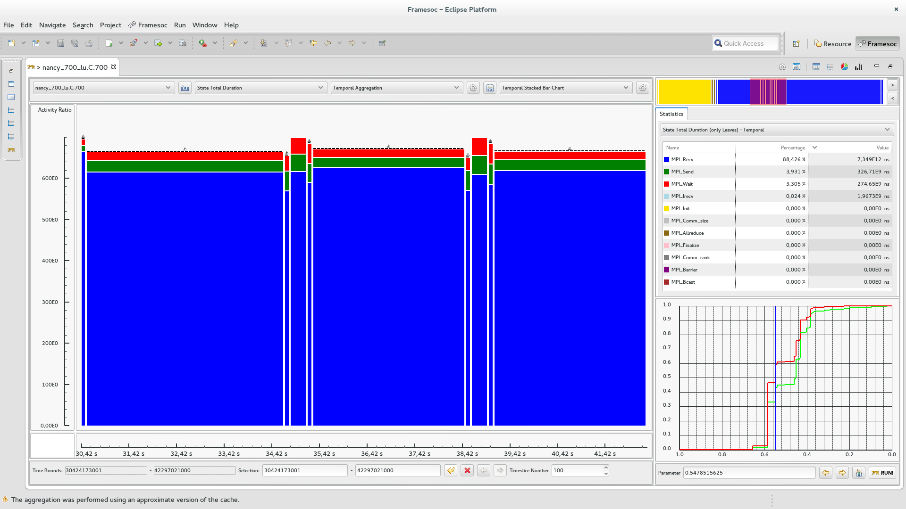
Shneiderman’s mantra: Zoom

Slide 80
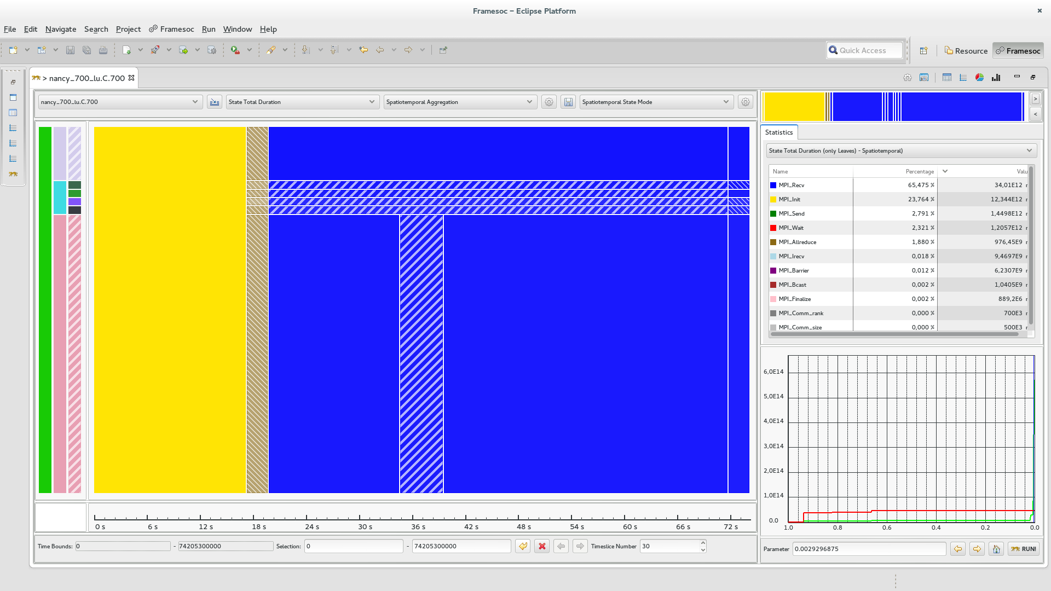
Shneiderman’s mantra: Zoom

Slide 81
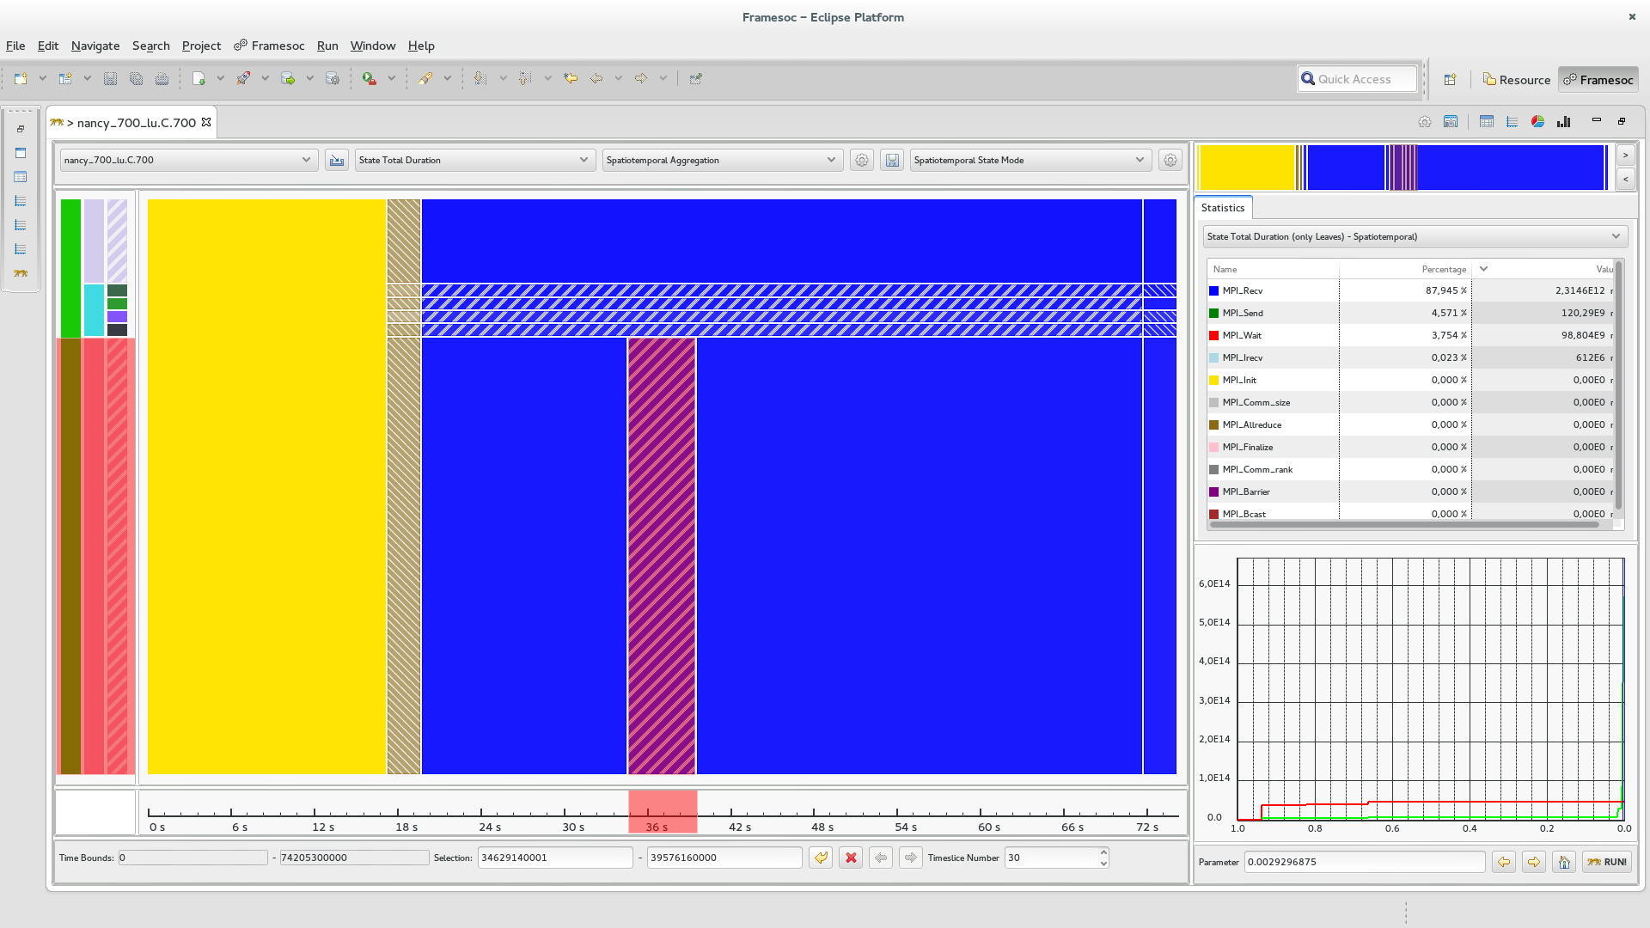
Shneiderman’s mantra: Zoom

Slide 82
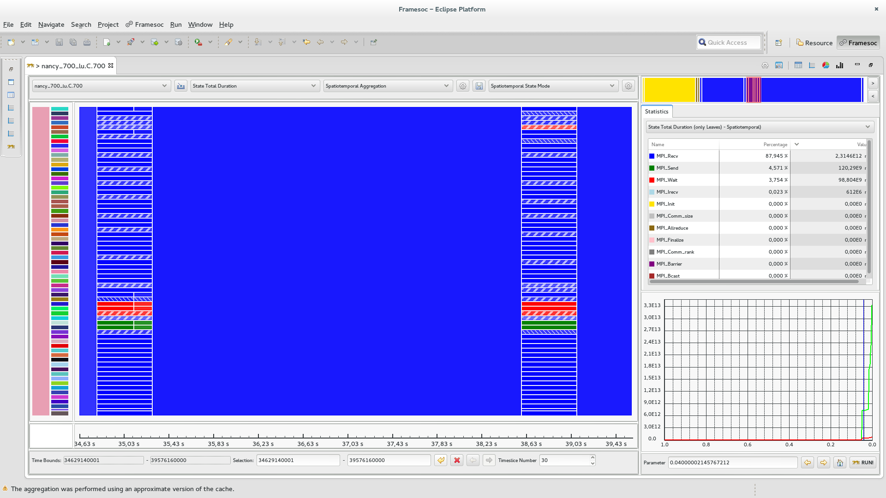
Shneiderman’s mantra: Zoom

Slide 83
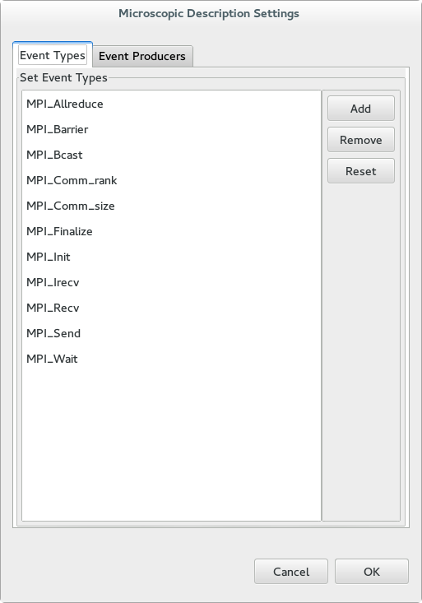
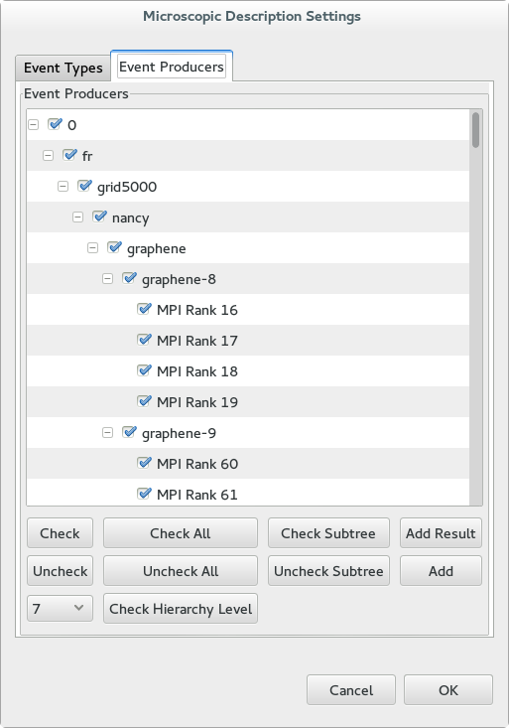
Shneiderman’s mantra: Filter
Event type filtering
Resource filtering

Slide 84
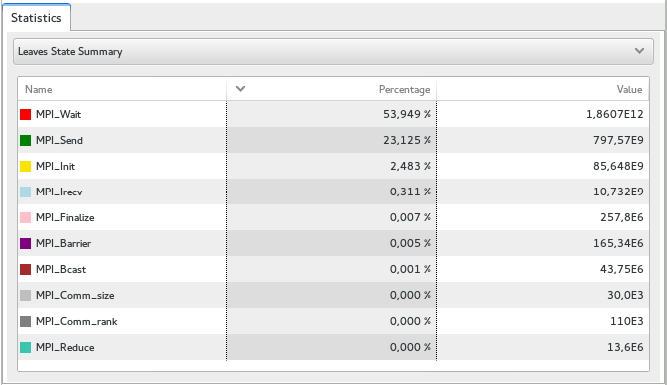
Shneiderman’s mantra: Details on demand

Slide 85
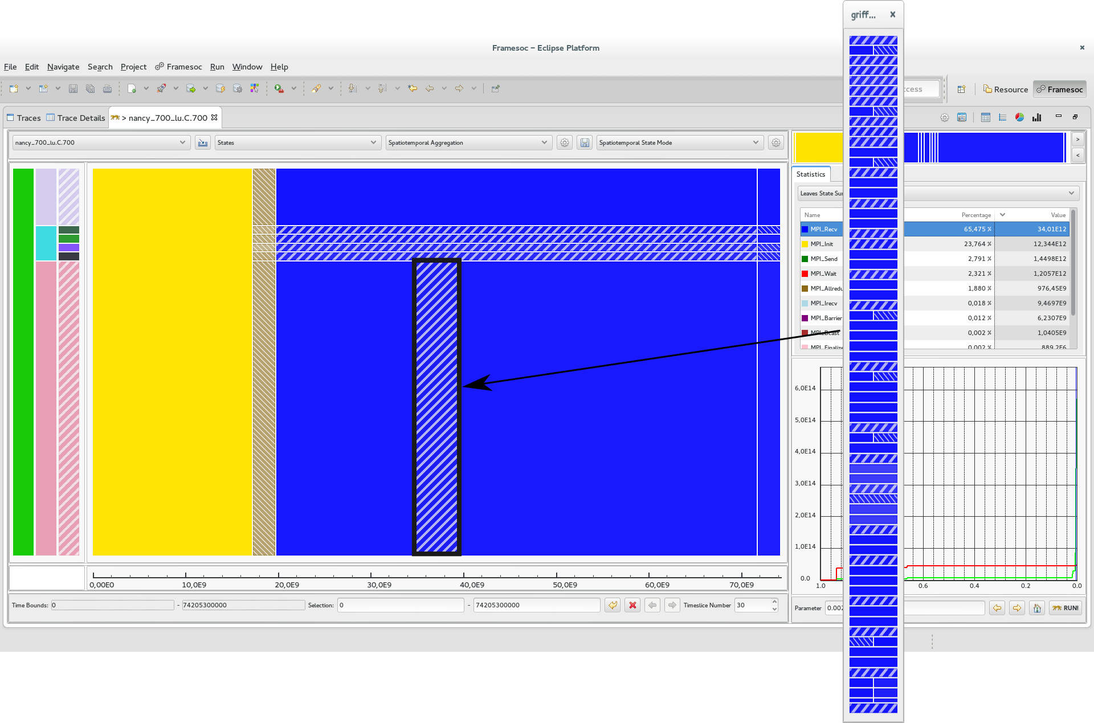
Shneiderman’s mantra: Details on demand

Slide 86
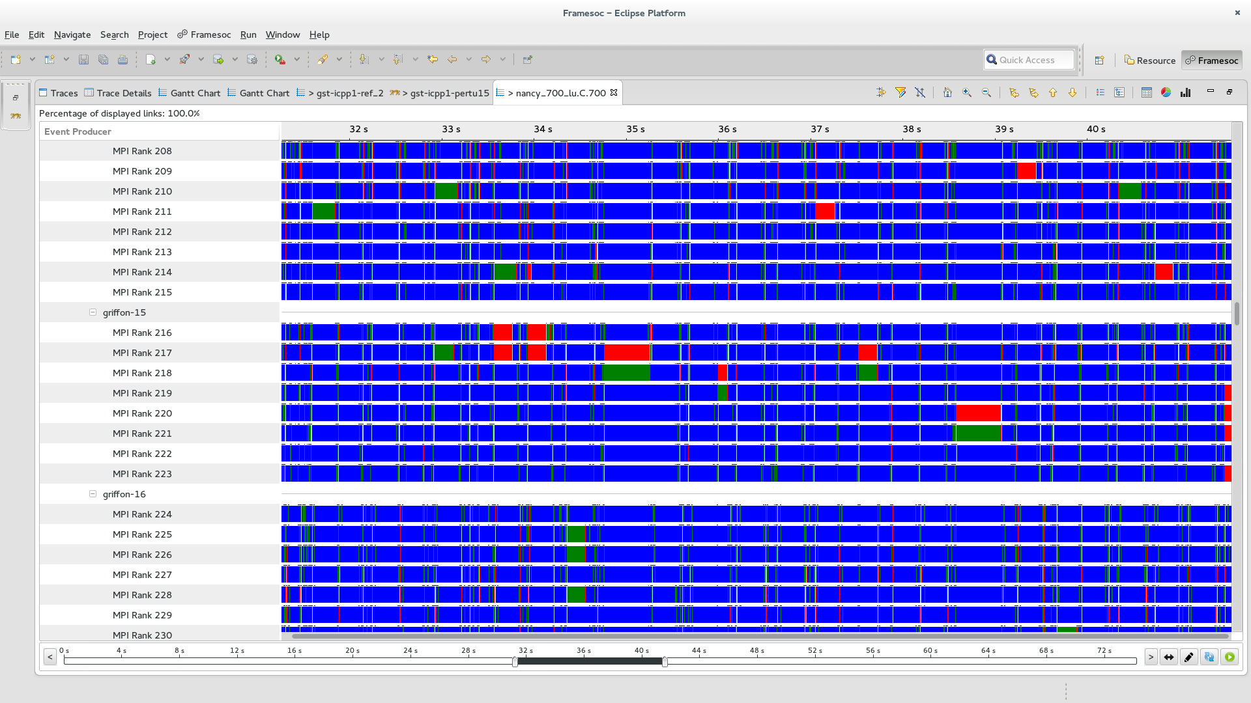
Shneiderman’s mantra: Details on demand

Slide 87


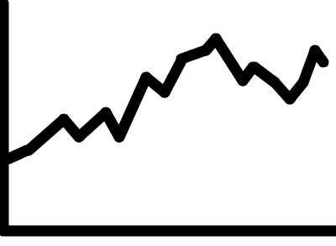
Performance
Microscopic Model
Cache
Query
Optimization
LPAggreg C++ library
Quality
Measures
Microscopic
Osbervation
Microscopic
Representation
Quality
Curves
Trace DB
Best Cut
Computation
Macroscopic
Representation
Visualization
Technique
Partition
Computation
Analyst

Slide 88
Query Optimization
Not optimized query: time interval + space elements + event types
Full overview: evaluate time, space and types is useless
Zoom or filter over less than 3 dimensions: queries can also be simplified
Advanced simplifications
Constant factor gain improves interactivity

Slide 89
Microscopic Model Persistant Cache
First Time :
Trace DB
Microscopic
Osbervation
Fine Time Slice
Granularity
Microscopic Model
Persistant
Cache
Microscopic
Model
Time slice numbers
are multiple
Perfect
Microscopic Model
Other Times:
Approximate
Microscopic Model
Persistant
Cache
Time slice numbers
are not multiple

Slide 90
Microscopic Model Persistant Cache
Cache Size << Microscopic Model (spare matrices)
Reading time only depends on microscopic model size (and content) and not on original trace file size

Slide 91
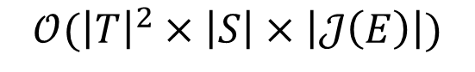

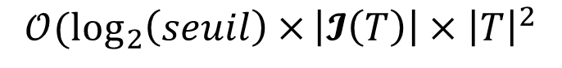
Temporal Aggregation
$$𝒪({\left|T\right|}^{2}×\left|S\right|×\left|𝒥\left(E\right)\right|)$$
$$𝒪(\log_{2}\left(seuil\right)×{\left|𝓘\left(T\right)\right|×\left|T\right|}^{2}$$
$$𝒪({\left|T\right|}^{2})$$
Fixed values: $\left|S\right|=1000, \left|𝒥\left(E\right)\right|=10, seuil=0.001$

Slide 92

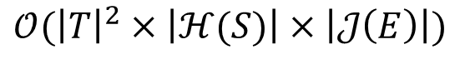
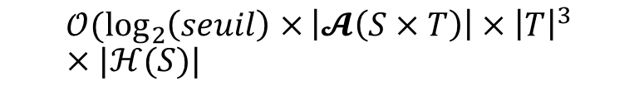
Spatiotemporal Aggregation
$$𝒪({\left|T\right|}^{2}×\left|ℋ(S)\right|×\left|𝒥\left(E\right)\right|)$$
$$𝒪(\log_{2}\left(seuil\right)×{\left|𝓐\left(S×T\right)\right|×\left|T\right|}^{3}×|ℋ(S)|$$
$$𝒪({\left|T\right|}^{3}×|ℋ(S)|)$$
Fixed values: $\left|𝒥\left(E\right)\right|=10, seuil=0.001$

Slide 93
In practice…
Real traces:
Up to 12 GB (218 million of events)
Temporal: ~1500 resources
Spatiotemporal: ~700 resources
Synthetic traces:
Up to 68 GB (2 billion of events)
Temporal: ~ 100 000 resources, 10 event types, 100 time slices
Spatiotemporal: ~10 000 resources, 10 event types, 30 time slices

Slide 94
Conclusion

Slide 95
Trace Overviews
Data aggregation following Lamarche-Perrin’s method
Temporal aggregation: significant extension to trace analysis
Spatiotemporal aggregation: new algorithm
Visualization techniques
Punctual visual aggregation
Compliant with Shneiderman’s mantra first step

Slide 96

Ocelotl Analysis Tool
Implementation of the overviews/data aggregation
Interaction mechanisms satisfying Shneiderman’s mantra
Performance ensuring for large traces
Modularity

Slide 97
Publications
International Conferences
A Spatiotemporal Data Aggregation Technique for Performance Analysis of Large-scale Execution Traces. Damien Dosimont, Robin Lamarche-Perrin, Lucas Mello Schorr, Guillaume Huard, Jean-Marc Vincent, IEEE Cluster 2014, pages 149-157, Madrid, September 2014.
Efficient Analysis Methodology For Huge Application Traces. Damien Dosimont, Generoso Pagano, Guillaume Huard, Vania Marangozova-Martin, Jean-Marc Vincent, 2014 International Conference on High Performance Computing & Simulation, pages 951-958, Bologna, June 2014.
Trace Management and Analysis for Embedded Systems. Generoso Pagano, Damien Dosimont, Guillaume Huard, Vania Marangozova-Martin, Jean-Marc Vincent, 2013 IEEE 7th International Symposium on Embedded Multicore Socs (MCSoC), pages 119-122, Tokyo, September 2013.
Workshops
Ocelotl: Large Trace Overviews Based on Multidimensional Data Aggregation. Damien Dosimont, Youenn Corre, Lucas Mello Schnorr, Guillaume Huard, Jean-Marc Vincent, 8th International Parallel Tools Workshop (IPTW’14), Stuttgart, October 2014.
Agrégation temporelle pour l’analyse de traces volumineuses. Damien Dosimont, Guillaume Huard, Jean-Marc Vincent, 10ème Atelier en Evaluation de Performances, Sophia Antipolis, June 2014.
La visualisation de traces, support à l’analyse, déverminage et optimisation d’applications de calcul haute performance. Damien Dosimont, Guillaume Huard, Jean-Marc Vincent, Atelier Visualisation d’informations, interaction et fouille de données (VIF) de la 13e Conférence Francophone sur l’Extraction et la Gestion des Connaissances (EGC’2013), pages 55-66, Toulouse, January 2013.

Slide 98

Perspectives?

Slide 99
New aggregations

Slide 100
Improving the performance
Parallelization
Trace reading
Algorithm
Data structures (spare matrixes)
Dynamic control
More caches
Prefetching, anticipation

Slide 101




New applications
Representation of preliminary abstracted traces
Trace comparison
Memory analysis
Other domains

Slide 102






Thanks

Slide 103
Backup

Slide 104
Main thread: a recording application
Streaming
Record
TV program
Set-top box
Hard drive
TS Record use case

Slide 105





Quality computation
Intermediate measures
Quality measures
$$Sum\left(S_{a},T_{\left(i,j\right)},J\right)=\sum_{s∈S_{a}}{\sum_{{t∈T}_{(i,j)}}{μ(s,t,J)}}$$
$$Gain(S_{a},T_{\left(i,j\right)},J)$$
$$Info({S_{a},T}_{\left(i,j\right)},J)$$
$$Loss(S_{a},T_{\left(i,j\right)},J)$$
$$Quality\left(S_{a},T_{\left(i,j\right)}\right)=\sum_{J∈𝒥(E)}{Quality(S_{a},T_{\left(i,j\right)},J)}$$
s1
=
+
S
s2
=
+
=
+

Slide 106

Complexity of multimedia applications

Slide 107


Elmqvist & Fekete’s criteria
Entity Budget
Visual Summary
Visual Simplicity
Discriminability
Fidelity
Interpretability

Slide 108
Overview: contributions
Data aggregation following Lamarche-Perrin’s method
Temporal aggregation: significant extension to trace analysis
Spatiotemporal aggregation: new algorithm
Visualization techniques
Punctual visual aggregation

Slide 109


How to build a polynomial algorithm?
Dynamic programming (divide and conquer)
Covering relation (lattice)
Quality measure additivity

Slide 110
Visualize structure and temporal behavior
Space-time diagram inspired by Gantt Chart
Exemple of a sequential pattern with context switches
Exemple of a parallel execution with communications

Slide 111



Best Partition problem
Find the partitions that maximize (minimize) quality measures
Quality measures are monotone, decomposable, and may be additive
$$X_{A}$$
$$Quality(𝒳) = Quality(X_{A}) + Quality(X_{B}) + Quality(X_{C})$$
5
1
9
1
$$X_{B}$$
2
4
$$X_{C}$$

Slide 112

Interest of spatiotemporal analysis

Slide 113

Fill the microscopic model
Event occurrences
Average state duration
Variable mean
Time slice
Time slice
Time slice
1 + 1 + 1
d1 + d2 + p1*d3
a
b
3
(d1+d2+p1*d3)/3
$$\frac{1}{b−a}\int_{a}^{b}{f\left(t\right)dt}$$

Slide 114




Partition the population
Set of partitions $𝓧$
Part $X$
5
1
9
1
Partial order
2
4
Partition $𝒳$

Slide 115

Complexity
Quantity of information required to encode a representation (theoretical)
Uncertainty about the elements of a description whose we only know the probability to appear of the different symbols that are associated with
$info\left(X\right)=−\sum_{x∈X}{p\left(x\right)\log_{2}{p(x)}}$ $info\left(𝓧\right)=\sum_{X∈𝓧}{info(X)}$
Complexity
5
5
5
1
1
1
1
1
1
9
9
9
2
2
2
4
4
4
Number of elements (aggregates)

Slide 116


In a few words…
Analysis of large execution traces, provided by
multimedia/embedded applications
parallel/scientific computing applications
Design of a method based on
visualization
data aggregation
interaction
following a top down approach
Design and implementation in an analysis software

Slide 117

Ex: Hierarchical aggregation
Spatial analysis
Admissible partitions

Slide 118

Ex: Ordered set aggregation
Temporal analysis
Admissible partitions

Slide 119

Build a microscopic model from the trace
Trace =
Nanoscopic
Model
Discretization
Microscopic
Model
Time continuous
Space discrete
Event types discrete
Time discrete
Space discrete
Event types discrete

Slide 120

Information contained in traces
Spatial dimension ($S$)
Hardware resources
Software components
Temporal dimension (T)
Events ($E$)
Categories ($𝒞(E)$):
Types ($𝒥(E)$)

Slide 121




Quality computation of monodimensional values
Monodimensional microscopic model
Intermediate measures
$$Sum(T_{(i,j)})=\sum_{{t∈T}_{(i,j)}}{μ(t)}$$
Time (discrete)
Data structure of time intervals T(i,j)
$$Info(T_{\left(i,j\right)})$$
Quality measures
i
$$Gain(T_{\left(i,j\right)})$$
$$Loss(T_{\left(i,j\right)})$$
j

Slide 122





Quality computation of multidimensional values
Intermediate measures
$$Sum(s,T_{\left(i,j\right)},J)=\sum_{{t∈T}_{(i,j)}}{μ(s,t,J)}$$
Jr
Jb
s1
$$Info({s,T}_{\left(i,j\right)},J)$$
Quality measures
s2
$$Gain(s,T_{\left(i,j\right)},J)$$
$$Loss(s,T_{\left(i,j\right)},J)$$
=
+
+
+
$$Quality(T_{(i,j)})=\sum_{s∈S}{\sum_{J∈𝒥(E)}{Quality(s,T_{\left(i,j\right)},J)}}$$

Slide 123


Best cut computation
Compute, compare, and select pIC for time intervals
pIC=p*gain-(1-p)*loss
User provides p
Already
computed
Ex: 4 time slices
$$pIC=pIC(T_{3})+pIC(T_{4})$$
Possible cuts: Cut[i]
i=4
Cut[4]=4
$$pIC=pIC(T_{(3,4)})$$
i=3
or
Cut[3]=3 or 4
i=2
or
or
Cut[2]=2, 3 or 4
or
or
i=1
Cut[1]=1, 2, 3 or 4
or

Slide 124

Rebuild the best partition
Example
Cut[1]?
Cut[1]=2
Cut[2+1]?
Cut[3]=3
Cut[3+1]?
Cut[4]=4
Best Partition

Slide 125
Aggregate and redistribute the values
Microscopic model
Partition
?
Aggregation (sum)
!
Uniform redistribution

Slide 126
Build a microscopic model from the trace
Trace =
Nanoscopic
Model
Discretization
+ Hierarchization
Microscopic
Model
Time continuous
Space flat
Event types discrete
Time discrete
Space hierarchized
Event types discrete

Slide 127



Performance
! Query optimization
Microscopic
model
Qualities
Quality curves
Abstraction
Trace (DB)
Visualization
! Microscopic Model
Cache

Slide 128


Main thread
Parameter p increasing
$$T$$
$$T$$

Slide 129



CG class C (64 processes) on G5K
64
Rennes
Activity Ratio
0
64
Nancy
Activity Ratio
0
64
Grenoble
Activity Ratio
0
0 s
26 s
54 s
125 s
Time

